Slide 1
Health care data analysis using excel
STUDENT NAME: PRIYADHARSHINI.V
REGISTER NO:422200038
DEPARTMENT:B.COM(INFORMATION SYSTEM MANAGEMENT)
COLLEGE:S.I.V.E.T. COLLEGE, GOWRIVAKKAM, CHENNAI.

Slide 2
PROJECT TITLE
Health care data analysis using excel

Slide 3


AGENDA
Problem Statement
Project Overview
End Users
Our Solution and Proposition
Dataset Description
Modelling Approach
Results and Discussion
Conclusion
3/21/2024 Annual Review

Slide 4

PROBLEM STATEMENT
Healthcare data, such as patient demographics, medical records, treatment outcomes, and hospital operations, be efficiently organized, analyzed, and visualized using Excel to improve decision-making, patient care, and resource management? The objective is to leverage Excel's analytical tools to identify trends, forecast outcomes, and optimize healthcare practices while ensuring data accuracy and security.

Slide 5

PROJECT OVERVIEW
This project focuses on leveraging Excel as a powerful tool for analyzing healthcare data to support better decision-making, improve patient outcomes, and optimize healthcare management. By using various datasets—such as patient demographics, medical history, treatment outcomes, and operational metrics—Excel's features, including pivot tables, data visualization, and statistical functions, will be utilized to extract valuable insights.
.
1. Data Organization and Cleaning
2. Analysis and Trends
3.Visualization
4. Forecasting
5.Reporting

Slide 6

WHO ARE THE END USERS?
1. Healthcare Administrators: They use Excel to track and analyze patient data, resource allocation, and operational efficiency to make informed decisions. 2. Doctors and Clinicians: Excel helps them analyze patient outcomes, compare treatments, and manage individual patient records or smaller datasets. 3. Researchers: They may use Excel for basic statistical analysis, organizing research data, or preparing data for more complex analysis tools. 4. Data Analysts: While they might use more advanced tools, they often use Excel for quick data cleaning, visualization, or reporting. 5. Insurance Companies: They can analyze claims, customer data, and predict trends in healthcare usage or costs using Excel.6. Pharmaceutical Companies: Excel helps them track drug trials, analyze sales data, and assess market performance.

Slide 7
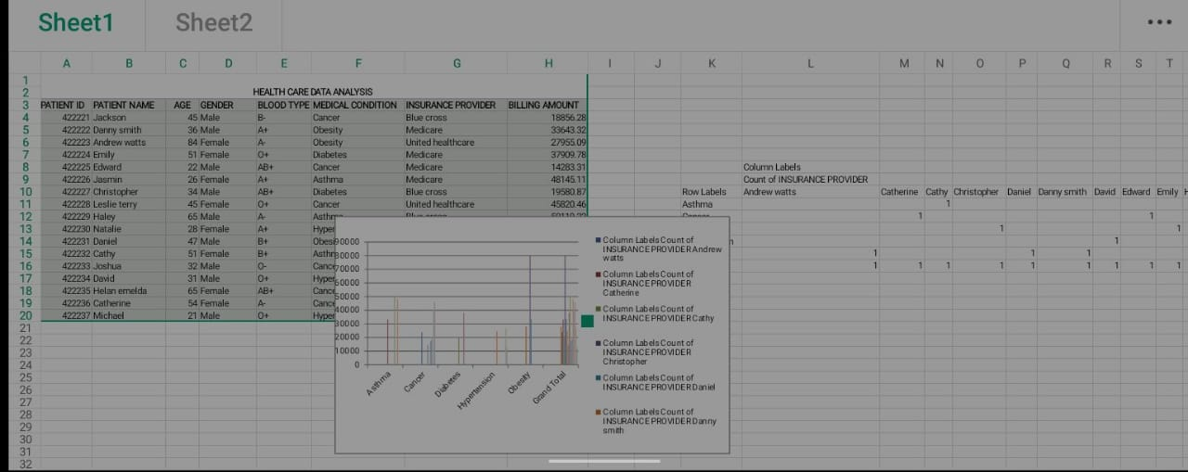

OUR SOLUTION AND ITS VALUE PROPOSITION

Slide 8
Dataset Description
Each column provides specific information about the patient, their admission, and the healthcare services provided, making this dataset suitable for various data analysis and modeling tasks in the healthcare domain. Here's a brief explanation of each column in the dataset -
Name: This column represents the name of the patient associated with the healthcare record. Age: The age of the patient at the time of admission, expressed in years. Gender: Indicates the gender of the patient, either "Male" or “Female”. Blood Type: The patient's blood type, which can be one of the common blood types (e.g., "A+", "O-", etc.). Medical Condition: This column specifies the primary medical condition or diagnosis associated with the patient, such as "Diabetes," "Hypertension," "Asthma," and more. Hospital: Identifies the healthcare facility or hospital where the patient was admitted. Billing Amount: The amount of money billed for the patient's healthcare services during their admission. This is expressed as a floating-point number.

Slide 9
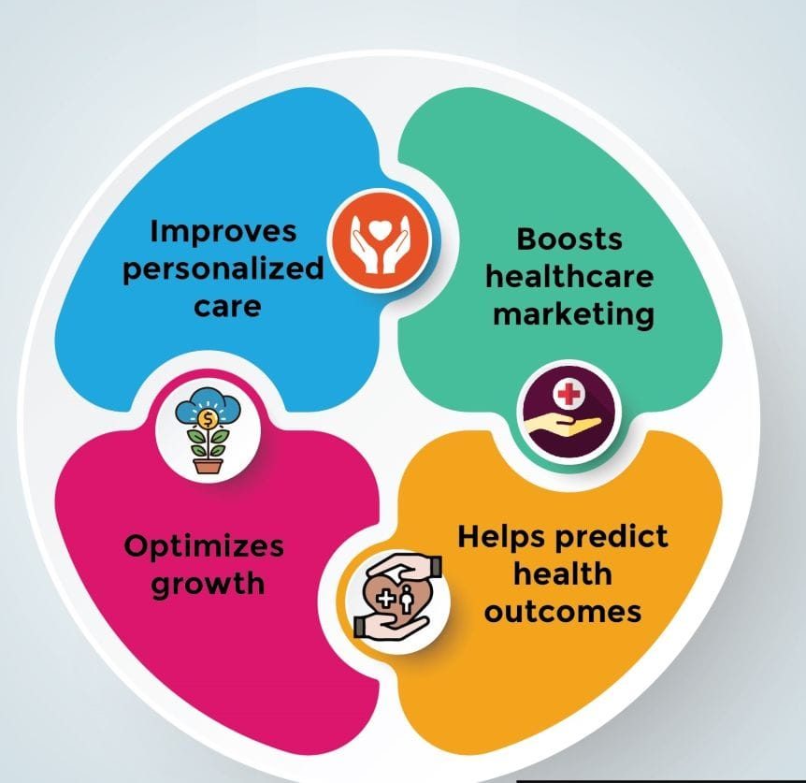

THE "WOW" IN OUR SOLUTION
3/21/2024 Annual Review
9

Slide 10
MODELLING
10

Slide 11
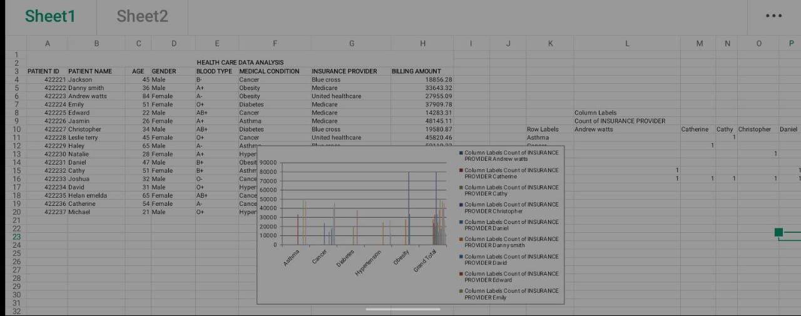
RESULTS
11

Slide 12
conclusion
Healthcare data analysis using Excel provides an accessible and efficient way to organize, analyze, and visualize data, helping healthcare professionals make data-driven decisions. By utilizing Excel's features like pivot tables, charts, and functions, users can easily identify trends, track patient outcomes, and optimize resource management.

